Slide 1
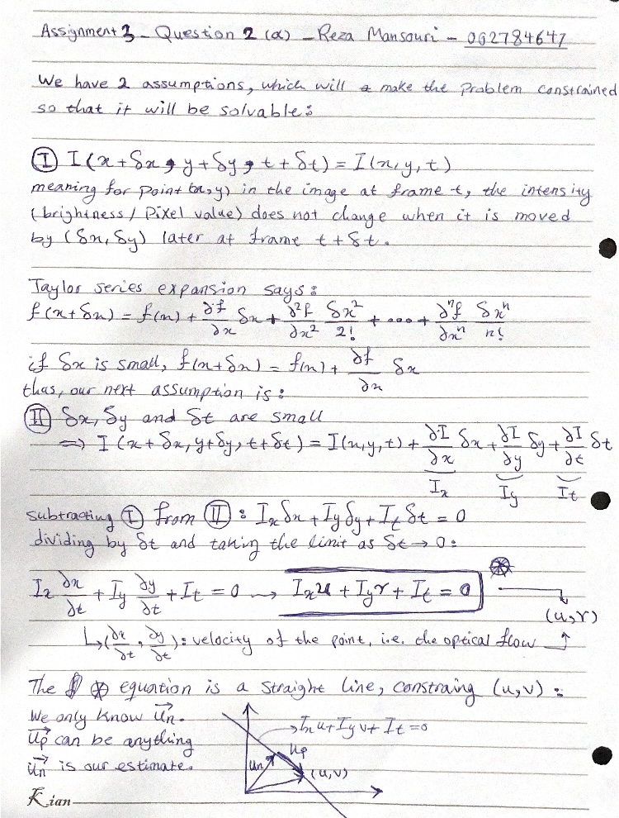
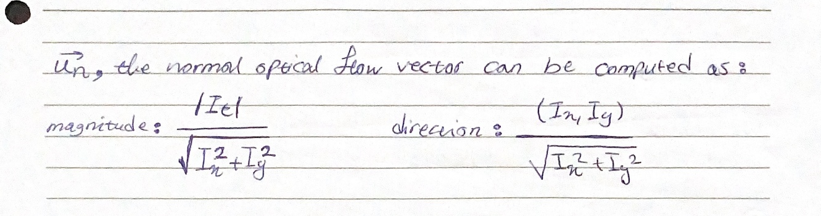

Slide 2


9 cm horizontal translation
870 px
645 px

Slide 3
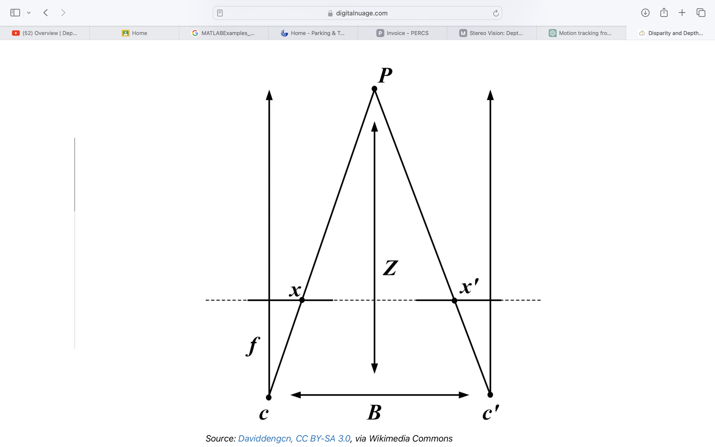
l₂
D
l₁
T

